Slide 1

Commerce
Data Service
Dr Tyrone Grandison
Deputy Chief Data Officer
April 5, 2016

Slide 2













The US Department of Commerce creates the conditions for economic growth and opportunity

Slide 3

Fifty Thousand Foot View

Slide 4
Mission
To empower people and business through Open Data and Transparency; both within and outside the Department.
To fundamentally change the way people and businesses interact with the DOC.
To super-charge the data initiatives in the DOC's bureaus.

Slide 5

Strategy
Build 21st century data product delivery into the bureaus’ DNA
Making bureaus more data-driven

Slide 6
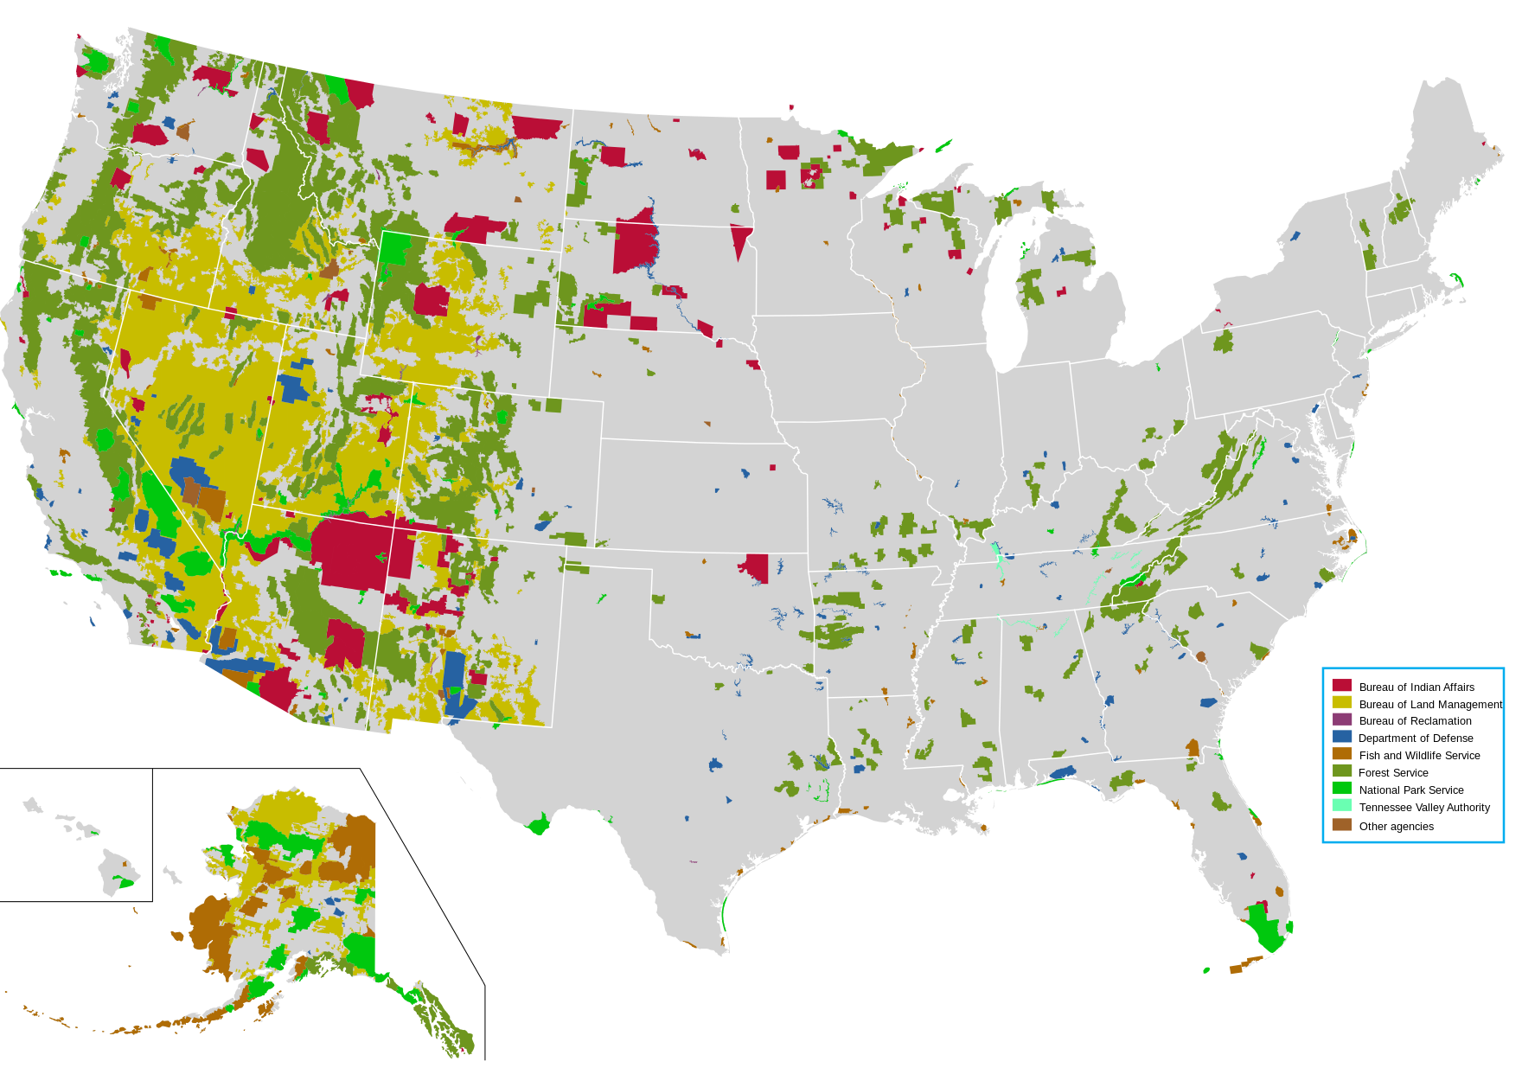
WHat WE DO
we Deliver
we Consult
we Train
we Partner
we Procure
Notes:
1 Deliver
a Research, design and build visually appealing, modern web interfaces and platforms
2 Consult
a Provide guidance on developing and executing data + tech roadmaps
b Assess current state and direction of a project and identify points for enhancement
c Collaboratively set flexible and functional policies to enable the use of tools, services, and software across DOC
d Identify new improvement opportunities and provide a strategic framework for acting on these opportunities
3 Train
a Offer data bootcamps through education partners such as General Assembly, University of Maryland
b Provide opportunity to extend training through short-term deployments along side top technologists at the Data Service
c Host workshops on agile methodology and design thinking
4 Partner/Procure
a Create and grow a marketplace of agile services (e.g. backend engineering, data science, UI/UX, cloud infrastructure, etc) that enable bureaus to procure tech services at the speed of need
b Stand up an Department-wide cloud sandbox to allow for rapid prototyping and research
c Consider the JV authority at NTIS.
At the highest levels:
We deliver value to our clients (i.e. American people and businesses) and partners (i.e. DOC bureaus, SMBs, American enterprises), by:
◦ enabling experimentation in a safe and collaborative environment.
◦ providing insight on current operations and recommendations for alignment with the industry's trajectory.
◦ providing guidance on and blueprints for open data solutions/alternatives
◦ providing MVPs for emerging open data applications.
◦ helping our clients discover and use DOC datasets.

Slide 7
Services Offered To bureaus
Data Product & Service Development & Delivery
Data Consulting
Data Infrastructure Guidance
Opening Data, Creating APIs, Testing & Optimizing Use
Data Integration, Analysis, Utilization & Visualization
Client Engagement
Tech Transfer and Open Sourcing
Notes:
Infrastructure
• Establish a central, shared service that enables any DOC bureau to modernize their technology platforms, in a cost-efficient manner:
◦ delivering faster transaction times for their operations;
◦ reducing internal interaction times; and
◦ increasing responsiveness to our clients - American businesses.
• Offer training opportunities for DOC employees that upskill them to current technology norms, practices and systems
• Create a menu of data services that can improve data management, thereby increasing the efficiency of operations
Open Data
• Guide bureaus in the production of truly open data sets that are machine-readable and instantly usable (i.e. CSV, JSON, XML)
• Provide a service to enhance discoverability and access to bureau data such that the Public can innovate
Analysis & Utilization
• Build data analytics capabilities to unlock insight and trends, aid the streamlining of operations, and inform decision making
• Demonstrate compelling, modern visualizations of the bureaus’ data to communicate insight more effectively
Engagement
• Grow and convene a diverse set of user communities that aid bureaus in developing solutions using data assets
• Provide feedback, e.g. user-directed feature requests, to the bureaus on the evolution of their data assets that their clients want.

Slide 8
VALue TO BUREAUS
Cost Savings and Cost Avoidance
Improved Data Quality
Improved Connection to Customers
Time Savings
Increased Budgets and Stakeholder Justifications
Public Recognition

Slide 9

The Current Year

Slide 10
Goal & Strategic Objectives
Strategic Goal:
Maximize the positive impacts of Commerce data on society.
Strategic Objectives:
Fuel economic growth by unleashing Commerce data and making it easier for businesses, communities, and citizens to access, analyze, and use the data.
Create data-driven government by combining and using data in new ways to increase the efficiency, effectiveness, and security of Commerce programs.
Deliver data services by leveraging advances in data science, software development, and standards to accelerate product innovations.

Slide 11
DOC’s Major 2016 Data Initiatives
Objectives
Strategies
Initiatives
Smart Cities Initiative – Census Bureau CitySDK 2.0, NIST Global Cities Challenge, NTIA Data Portal
21st Century Economic Data – Census Bureau/BEA Data Optimization Study, BEA website redesign, BEA Digital Economy Price Indexes Roadmap.
Modernize Patent Data – USPTO Big Data Analytics Program, USPTO Patent Examination Data Search, USPTO Developer Page.
Accelerate Weather and Climate Data Use – NOAA Big Data Project, NOAA Data Citation project.
Unleash Scientific Data – NIST Materials Data Curation System, NIST Standard Reference Data Modernization, NIST Measurement Data Management Project.
Trade Data Services – ITA Exporters Data Project, ITA/BIS Trade Developer Portal, Foreign Trade Data Integration at BOC/BEA/ITA/BIS.
Fueling Economic Growth
Creating Data-Driven Government
Census Innovation – 2020 Census Re-engineering, American Community Survey Redesign, Census Bureau Income Data Project.
Administrative Data Sharing – ESA Data Synchronization Effort.
Performance Analytics – DATA Act implementation.
Commerce Data Service (CDS) – Entrepreneurial team delivers products to Bureaus.
Software Developer Toolkits – All Bureaus: new developer tools development, Data Usability Project public launch, agile delivery methodology deployment.
National Technical Information Service – Evolution Action Plan implementation.
Delivering Data Services

Slide 12
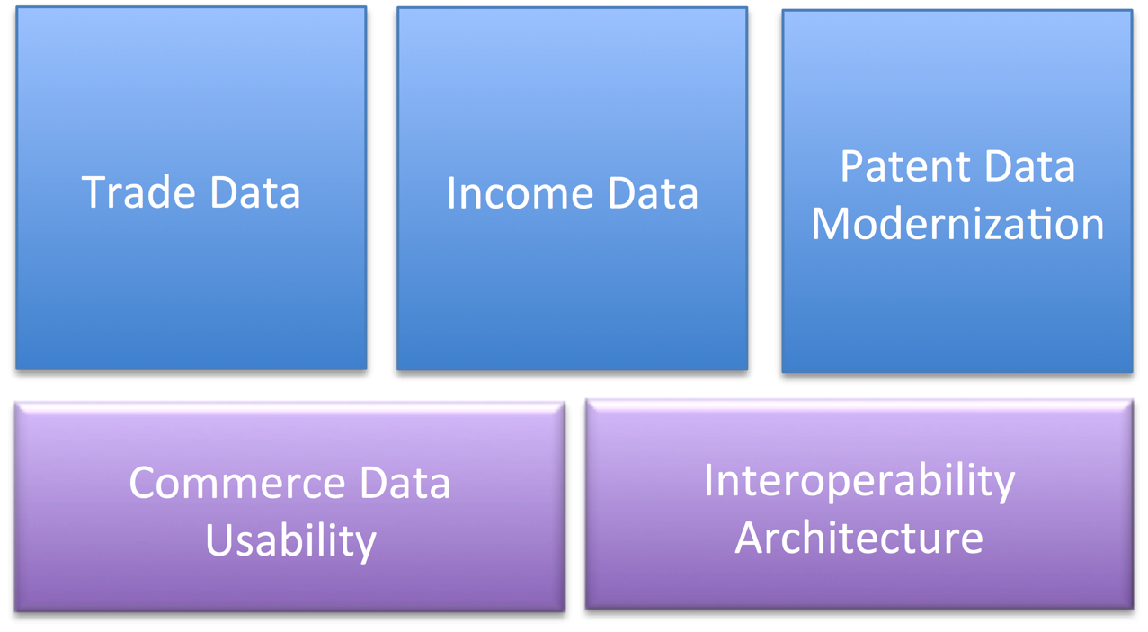
2016 CDS Project Priorities

Slide 13
2016 CDS Funding Bureaus

Slide 14
What We Ask of Bureaus when Working with CDS
Have or Choose an empowered Product Owner
Someone who can handle internal bureau discussions, present a unified bureau voice, and provide feedback promptly to project questions.
Read our Stakeholder Guidelines document.
User-Centered Design - Expect us to talk to your end users to verify and refine project goals.
Change is the only constant – expect project goals to evolve.
Build – Measure – Learn
Expect a high initial failure rate. Lessons learned are incorporated into future iterations.
Be prepared to collaborate through numerous iterations of product development.
We practice Agile Development and Lean Startup methodology.

Slide 15
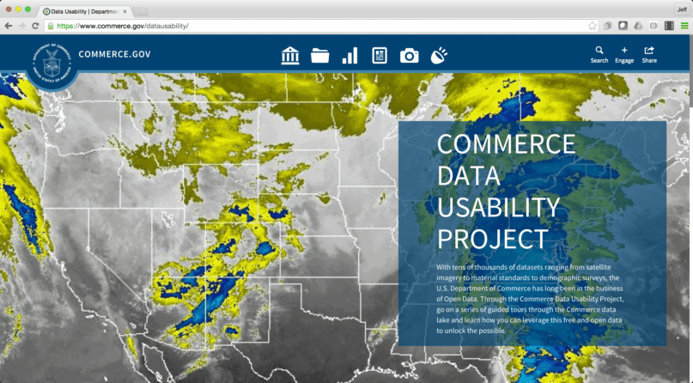
Commerce Data Usability Project
commerce.gov/datausability

Slide 16
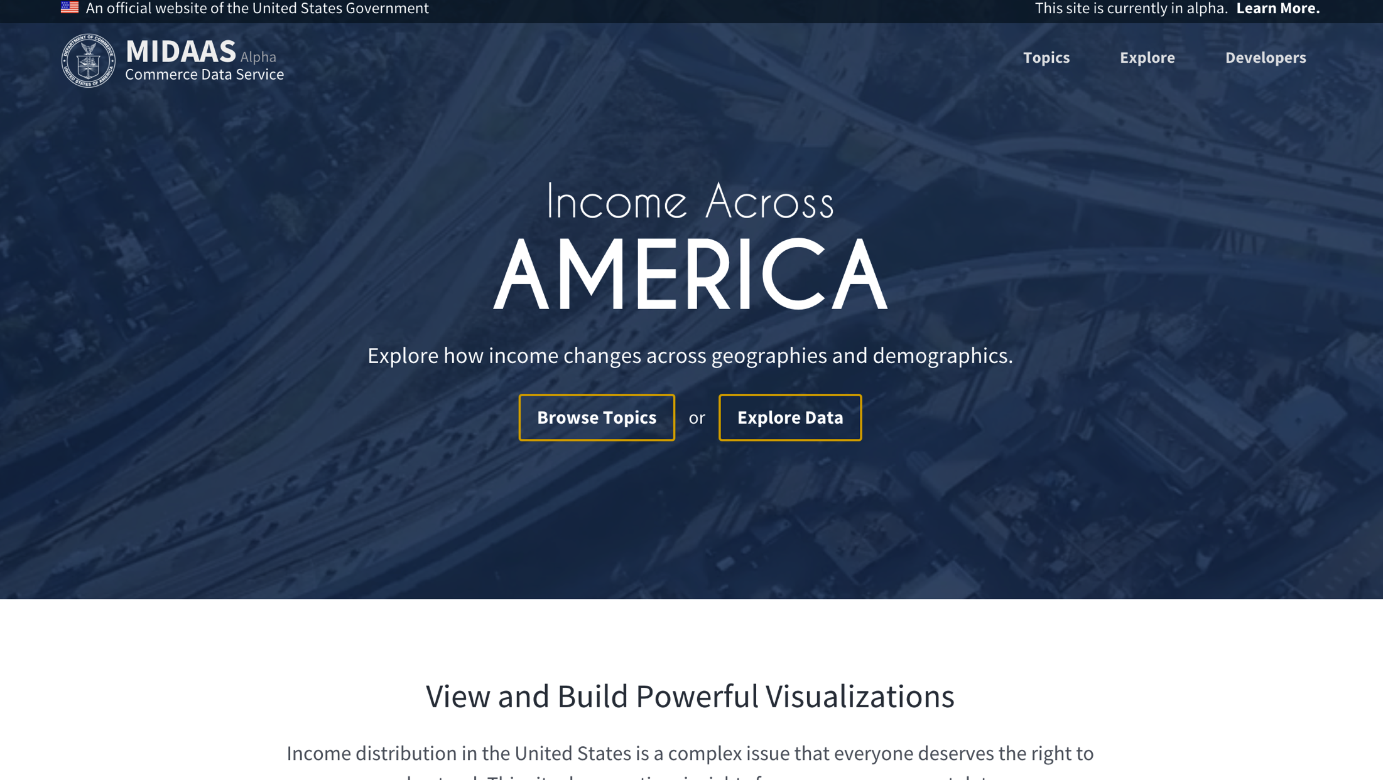
The MIDAAS Project
https://midaas.commerce.gov

Slide 17
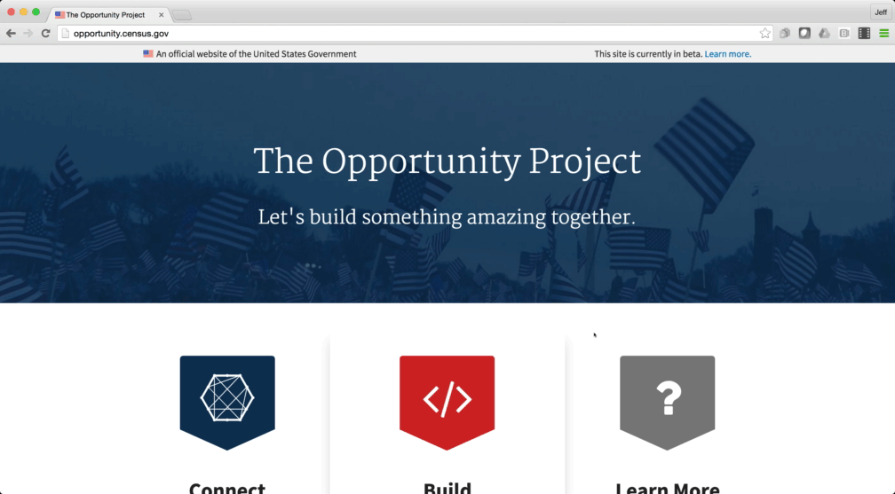
The Opportunity Project
opportunity.census.gov

Slide 18
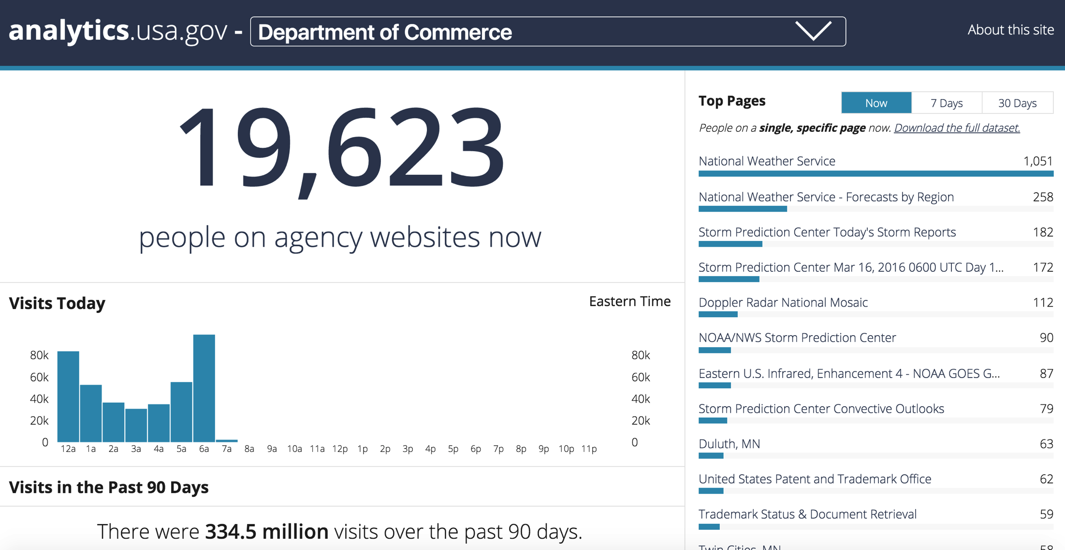
DOC Web Analytics Dashboard
https://analytics.usa.gov/commerce/

Slide 19

Help Girls of Color
http://www.helpgirlsofcolor.org

Slide 20
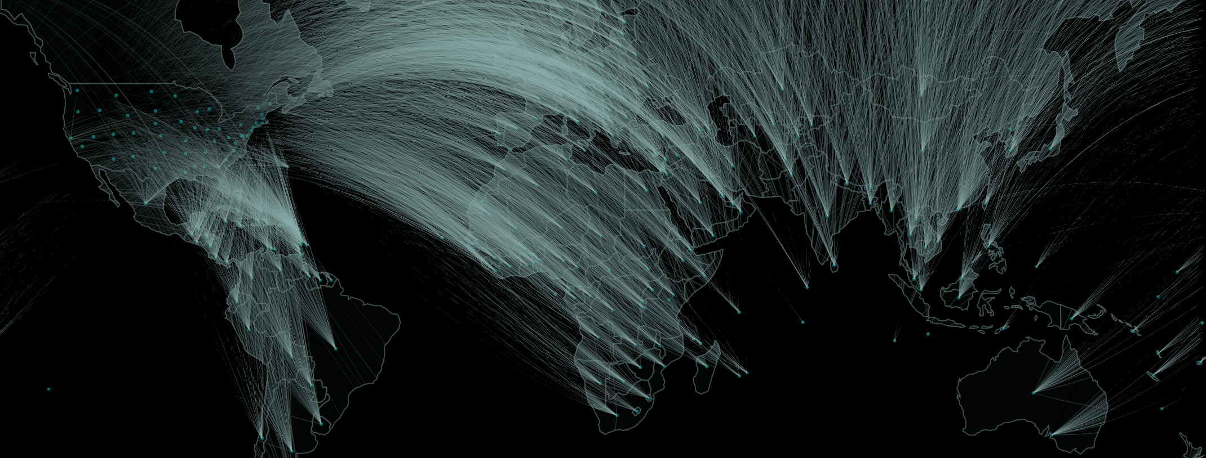
New Exporters Initiative
Inform new strategies for communicating and connecting with businesses to encourage exporting
Serve as a testbed for optimizing how services are offered and delivered to businesses across different industries
Operationalize a vision for data-driven government

Slide 21
Delivering
Commerce Data Academy
Web ReDesign
BEA RIMSS
NOAA Data Portal
Patent Data
Developer Portal
Big Data Science Models
Infrastructure for Data Science projects

Slide 22

The Team

Slide 23
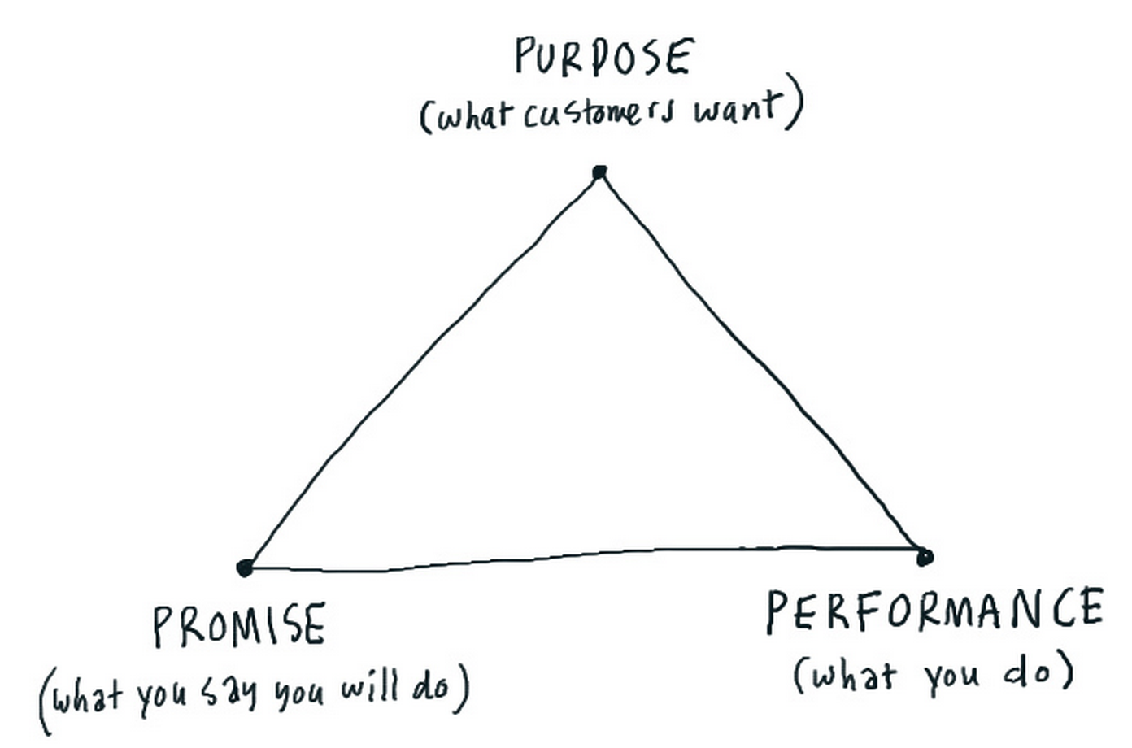
Team MEMBER EXPECTATIONS
Be skilled at communication
Communicating their work (and results) to executives and clients.
Communicating with team members.
Have a collaborative mindset.
Know and practice of Agile and Lean startup methodologies.
Know and practice user-centered design.
Be outcomes-driven.
Work in the open and in community.

Slide 24
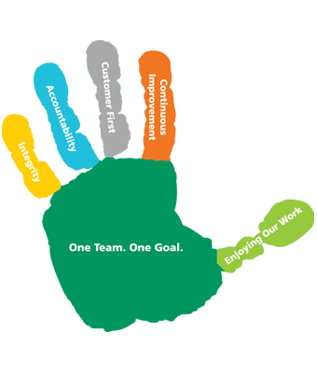
Team values
Open
Everything in public.
Collaboration and Co-creation
No impostors. One team. Ask for help. Partner often. Improve everything.
Communication
Communicate often and meaningfully. Document everything.
Curiosity
Constantly learning. Constantly automating. Constantly teaching.
Fun

Slide 25




commerce.gov/dataservice
data@doc.gov
@CommerceGovData

